Slide 1

ETEC-303 Digital Communication Lecture - 1
Instructor:
Abhishek Gagneja
Digital Communication Slides

Slide 2
Why Digitise?
Easier Data recording and storage
Lesser effect of distortion, noise or interference
Digital circuits are cheaper to design and have a much more flexible hardware implementation
Signal processing is much more convenient
Data encryption and security is much easier
Time Division Multiplexing in digital systems is much easier to implement than FDM
Information channel capacity is much better utilized by digital signals
High fidelity transmission since regenerative repeating is possible
20 July 2020
Digital Communication Slides

Slide 3
Typical DCS block diagram
Unit -4
Data
Analog to Digital Conversion
Source Coding/
Channel Coding/
Cryptography
Line Coding
Bandpass modulation
Unit -1
Unit -1
Information Theory and Coding
Unit -3
Channel
Unit -3
Received
Data
Digital to Analog Conversion
Source Decoding/
Channel Decoding/
Unscrambling
Digital data recovery
Bandpass de-modulation
Unit -4
20 July 2020
Digital Communication Slides

Slide 4
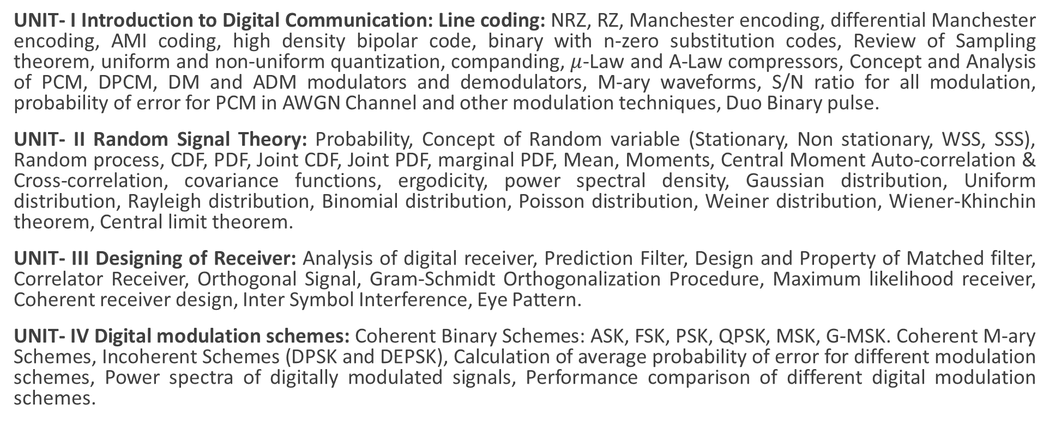
Syllabus
UNIT- I Introduction to Digital Communication: Line coding: NRZ, RZ, Manchester encoding, differential Manchester encoding, AMI coding, high density bipolar code, binary with n-zero substitution codes, Review of Sampling theorem, uniform and non-uniform quantization, companding, $μ$-Law and A-Law compressors, Concept and Analysis of PCM, DPCM, DM and ADM modulators and demodulators, M-ary waveforms, S/N ratio for all modulation, probability of error for PCM in AWGN Channel and other modulation techniques, Duo Binary pulse.
UNIT- II Random Signal Theory: Probability, Concept of Random variable (Stationary, Non stationary, WSS, SSS), Random process, CDF, PDF, Joint CDF, Joint PDF, marginal PDF, Mean, Moments, Central Moment Auto-correlation & Cross-correlation, covariance functions, ergodicity, power spectral density, Gaussian distribution, Uniform distribution, Rayleigh distribution, Binomial distribution, Poisson distribution, Weiner distribution, Wiener-Khinchin theorem, Central limit theorem.
UNIT- III Designing of Receiver: Analysis of digital receiver, Prediction Filter, Design and Property of Matched filter, Correlator Receiver, Orthogonal Signal, Gram-Schmidt Orthogonalization Procedure, Maximum likelihood receiver, Coherent receiver design, Inter Symbol Interference, Eye Pattern.
UNIT- IV Digital modulation schemes: Coherent Binary Schemes: ASK, FSK, PSK, QPSK, MSK, G-MSK. Coherent M-ary Schemes, Incoherent Schemes (DPSK and DEPSK), Calculation of average probability of error for different modulation schemes, Power spectra of digitally modulated signals, Performance comparison of different digital modulation schemes.
20 July 2020
Digital Communication Slides

Slide 5
Expected Course Outcomes
Ability to define, understand and explain the concepts of Baseband Digital Communication Systems, like PCM, Delta Modulation and DPCM, etc.
Ability to understand the use of Random variables and random processes, their concept and their applications.
Ability to understand the bit detection and reception techniques for digital communication systems
Ability of define, understand and explain the concept of Bandpass Digital Communication systems, like ASK, FSK, PSK, QPSK, MSK, etc.
Ability to understand the probability of error and signal to noise ratio for various forms of digital communication systems
Ability to apply the various logics learnt in this course in different Digital Communication applications
20 July 2020
Digital Communication Slides

Slide 6
Evaluation Methodology
5 Quizzes will be conducted, best 4 will be considered – 1 mark each Total : 4 marks
2 Design Problems will be assigned – 1 mark each Total : 2 marks
1 Class test will be conducted – 4 marks Total : 4 marks
Mid term examination (30 marks scaled down to 15) Total : 15 marks
Total Internal evaluation = 25 marks
External Evaluation = 75 marks
20 July 2020
Digital Communication Slides

Slide 7
Online Learning Resources
Digital Communication by Prof. Surendra Prasad
https://nptel.ac.in/courses/108/102/108102096/
Principles of Digital Communication by Prof. Abhishek Dixit
https://nptel.ac.in/courses/108/102/108102120/
Principles of Digital Communications by Prof. S. N. Merchant
https://nptel.ac.in/courses/108/101/108101113/
20 July 2020
Digital Communication Slides

Slide 8
Textbooks
Communication Systems 4th ed. – Simon Haykins
Digital Communication – Simon Haykins
Digital Communication – Bernard Sklar
Principles of Communication Systems – Taub Schilling
Extended reading
Modern Digital and Analog communication systems – B. P. Lathi
Digital Communication – John G. Proakis
20 July 2020
Digital Communication Slides

Slide 9




